Slide 1


Knowledge Representation Meets Machine Learning: Part 2/3
William W. Cohen Machine Learning Dept and Language Technology Dept
joint work with:
William Wang, Kathryn Rivard Mazaitis

Slide 2
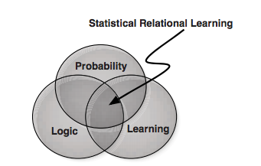
Background
H/T: “Probabilistic Logic Programming, De Raedt and Kersting

Slide 3
Logic
Scalability
Machine Learning
Probabilistic
First-order
Methods
Abstract Machines, Binarization
Scalable Probabilistic
Logic
Scalable ML

Slide 4
Outline
Motivation
Background
Logic
Probability
Combining logic and probabilities: MLNs
ProPPR
Key ideas
Learning method
Results for parameter learning
Structure learning for ProPPR for KB completion
Comparison to neural KBC models
Joint IE and KB completion
Beyond ProPPR
….

Slide 5
Background: Logic Programs
Logic program is DB of facts + rules like:
grandparent(X,Y) :- parent(X,Z),parent(Z,Y)
parent(alice,bob). parent(bob,chip). parent(bob,dana).
Alphabet: possible predicates and constants
Atomic formulae: parent(X,Y), parent(alice,bob)
An interpretation of a program is a subset of the Herbrand base H (H = all ground atomic fmla).
A model is an interpretation consistent with all the clauses A:-B1,…,Bk of the program:
if Theta(B1) in H and .. And Theta(Bk) in H then Theta(A) in H, for any Theta:vars→constants
The smallest model is the deductive closure of the program
H/T: “Probabilistic Logic Programming, De Raedt and Kersting

Slide 6
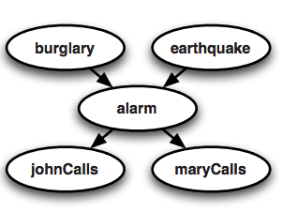
Background: Probabilistic inference
Random variable: burglary, earthquake, …
Usually denote with upper-case letters: B,E,A,J,M
Joint distribution: Pr(B,E,A,J,M)
B | E | A | J | M | prob
T | T | T | T | T | 0.00001
F | T | T | T | T | 0.03723
…
H/T: “Probabilistic Logic Programming, De Raedt and Kersting

Slide 7
Background: Markov networks
Random variable: B,E,A,J,M
Joint distribution: Pr(B,E,A,J,M)
Undirected graphical models give another way of defining a compact model of the joint distribution…via potential functions.
ϕ(A=a,J=j) is a scalar measuring the “compatibility” of A=a J=j
x
x
x
x
A | J | ϕ(a,j)
F | F | 20
F | T | 1
T | F | 0.1
T | T | 0.4

Slide 8
Background
x
x
x
x
…
…
clique potential
A | J | ϕ(a,j)
F | F | 20
F | T | 1
T | F | 0.1
T | T | 0.4
ϕ(A=a,J=j) is a scalar measuring the “compatibility” of A=a J=j

Slide 9
MLNs are one blend of logic and probability
p(a,b) | m(a,b) | ϕ
T | F | 10
T | F | 10
T | T | 10
F | T | 0.5
C1 grandparent(X,Y) :- parent(X,Z),parent(Z,Y)
C2 parent(X,Y):-mother(X,Y).
C3 parent(X,Y):-father(X,Y).
father(bob,chip). parent(bob,dana). mother(alice,bob). …
p(a,b)
p(a,b):-m(a,b)
m(a,b)
gp(a,c)
gp(a,c):-p(a,b),p(b,c)
f(b,c)
p(b,c):-f(b,c)
p(b,c)

Slide 10
MLNs are powerful ☺ but expensive ☹
Many learning models and probabilistic programing models can be implemented with MLNs
Inference is done by explicitly building a ground MLN
Herbrand base is huge for reasonable programs: It grows faster than the size of the DB of facts
You’d like to able to use a huge DB—NELL is O(10M)
Inference on an arbitrary MLN is expensive: #P-complete
It’s not obvious how to restrict the template so the MLNs will be tractable

Slide 11
What’s the alternative?
There are many probabilistic LPs:
Compile to other 0th-order formats: (Bayesian LPs, PSL, ProbLog, ….), to be more appropriate and/or more tractable
Impose a distribution over proofs, not interpretations (Probabilistic Constraint LPs, Stochastic LPs, Problog, …):
requires generating all proofs to answer queries, also a large space
space of variables goes from H to size of deductive closure
Limited relational extensions to 0th-order models (PRMs, RDTs, MEBNs, …)
Probabilistic programming languages (Church, …)
Our work (ProPPR)

Slide 12
ProPPR
Programming with Personalized PageRank
My current effort to get to: probabilistic, expressive and efficient

Slide 13
Relational Learning Systems
Task
2. First order program
3. “Compiled” representation
Inference | Learning
formalization
+DB
“compilation”

Slide 14
Relational Learning Systems
MLNs
Task |  | Task
2. First order program |  | Clausal 1st-order logic
3. “Compiled” representation |  | Undirected graphical model
Inference | Learning | approx | approx
formalization
easy
+DB
very expressive
“compilation”
expensive
grows with DB size
intractible

Slide 15
Relational Learning Systems
MLNs
ProPPR
Task |  | Task |  | Task
2. First order program |  | Clausal 1st-order logic |  | Function-free Prolog (Datalog)
3. “Compiled” representation |  | Undirected graphical model |  | Graph with feature-vector labeled edges
Inference | Learning | approx | approx | PPR (RWR) | pSGD
formalization
easy
harder?
+DB
“compilation”
sublinear in DB size
expensive
fast
can parallelize
linear
fast, but
not convex

Slide 16
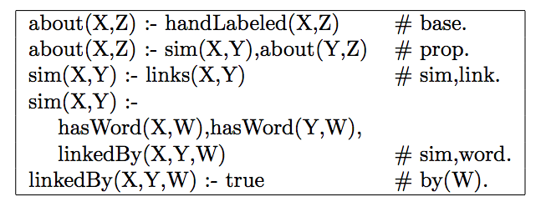
A sample program

Slide 17
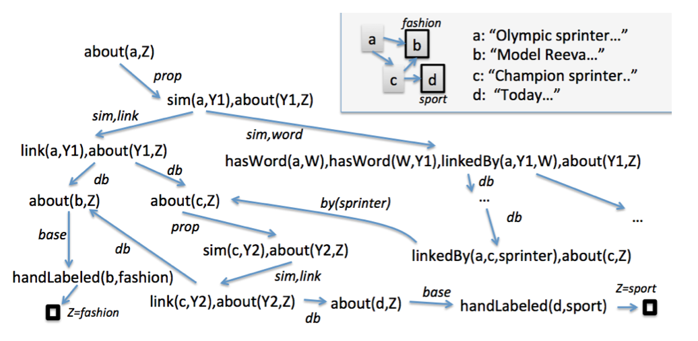
Query: about (a,Z)
DB
Program + DB + Query define a proof graph, where nodes are conjunctions of goals and edges are labeled with sets of features.
Program (label propagation)
LHS ➔ features

Slide 18
Every node has an implicit reset link
Low probability
High probability
Short, direct paths from root
Longer, indirect paths from root
Transition probabilities, Pr(child|parent), plus Personalized PageRank (aka Random-Walk-With-Reset) define a distribution over nodes.
Very fast approximate methods for PPR
Transition probabilities, Pr(child|parent), are defined by weighted sum of edge features, followed by normalization.
Learning via pSGD

Slide 19
Approximate Inference in ProPPR
Score for a query soln (e.g., “Z=sport” for “about(a,Z)”) depends on probability of reaching a ☐ node*
“Grounding” (proof tree) size is O(1/αε) … ie independent of DB size ➔ fast approx incremental inference (Reid,Lang,Chung, 08)
---
α is reset probability
*as in Stochastic Logic Programs
[Cussens, 2001]
Basic idea: incrementally expand the tree from the query node until all nodes v accessed have weight below ε/degree(v)

Slide 20
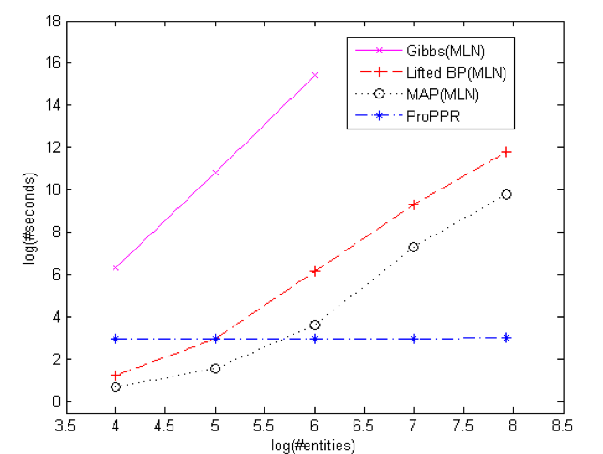
Inference Time: Citation Matching vs Alchemy
Same queries, different DBs of citations
“Grounding”cost is independent of DB size

Slide 21
Accuracy: Citation Matching
AUC scores: 0.0=low, 1.0=hi
w=1 is before learning

Slide 22
Approximate Inference in ProPPR
Score for a query soln (e.g., “Z=sport” for “about(a,Z)”) depends on probability of reaching a ☐ node*
“Grounding” (proof tree) size is O(1/αε) … ie independent of DB size ➔ fast approx incremental inference (Reid,Lang,Chung, 08)
---
α is reset probability
*as in Stochastic Logic Programs
[Cussens, 2001]
Each query has a separate grounding graph.
Training data for learning:
(queryA, answerA1, answerA2,….)
(query B, answer B1,…. )
…
Each query can be grounded in parallel, and PPR inference can be done in parallel

Slide 23
Results: AUC on NELL subsets Wang et al., (Machine Learning 2015)
* KBs overlap a lot at 1M entities

Slide 24
Results – parameter learning for large mutually recursive theories
[Wang et al, MLJ, in press]
Theories/programs learned by PRA (Lao et al) over six subsets of NELL, rewritten to be mutullyy recursive
100k facts in KB
1M facts in KB
 | #rules | AUC | sec | #rules | AUC | sec
PRA 1 | ~ 430-540 | 88.4 – 95.2 | 5-10s with 16 threads | ~ 550 | 95.5 | 15-18s with 16 threads
PRA 2 | ~ 620-770 | 91.6 – 95.4 |  | ~ 800 | 96.0
PRA 3 | ~800-1000 | 95.2 – 95.9 |  | ~1000 | 96.4
Alchemy MLNs: 960 – 8600s for a DB with 1k facts

Slide 25
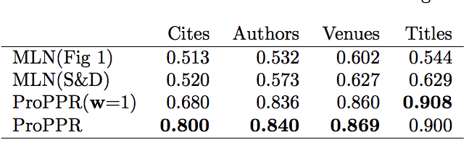
Accuracy: Citation Matching
Our rules
UW rules
AUC scores: 0.0=low, 1.0=hi
w=1 is before learning
(i.e., heuristic matching rules,
weighted with PPR)

Slide 26
Outline
Motivation
Background
Logic
Probability
Combining logic and probabilities: MLNs
ProPPR
Key ideas
Learning method
Results for parameter learning
Structure learning for ProPPR for KB completion
Comparison to neural KBC models
Joint IE and KB completion
Beyond ProPPR
….

Slide 27
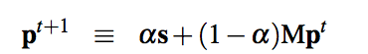
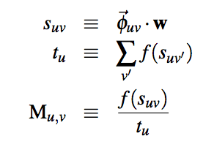
Parameter Learning in ProPPR
PPR probabilities are a stationary distribution of a Markov chain
reset
M is transition probabilities for proof graph, p is PPR score
Transition probabilities u→v are derived by linearly combining features of an edge, applying a squashing function f, and normalizing
f is exp, truncated tanh, ReLU…

Slide 28
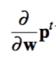
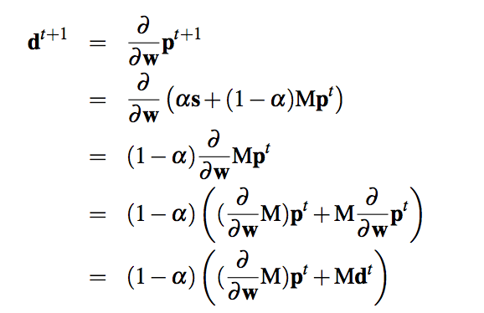
Parameter Learning in ProPPR
PPR probabilities are a stationary distribution of a Markov chain
Learning uses gradient descent: derivative d^{t} of p^{t} is :
Overall algorithm not unlike backprop…we use parallel SGD

Slide 29
Parameter learning in ProPPR
Example: classification
predict(X,Y) :- pickLabel(Y),testLabel(X,Y).
testLabel(X,Y) :- true # { f(FX,Y) : featureOf(X,FX) }.
predict(x7,Y)
pickLabel(Y),testLabel(x7,Y)
testLabel(x7,y1)
…
testLabel(x7,yK)
f(a,y1),f(b,y1),…
f(a,y1),f(b,y1),…
f0
~
~
Learning needs to find a weighting of features depending on specific x and y that leads to the right classification.
(The alternative at any testLabel(x,y) goal is a reset.)

Slide 30
Parameter learning in ProPPR
Example: hidden unit/latent features
predH1(x,Y)
predictH1(X,Y) :-
pickH1(H1),
testH1(X,H1),
predictH2(H1,Y).
predictH2(H1,Y) :-
pickH2(H2),
testH2(H1,H2),
predictY(H2,Y).
predictY(H2,Y):-
pickLabel(Y),
testLabel(H2,Y).
testH1(X,H) :- true
#{ f(FX,H) : featureOf(X,FX) }.
testH2(H1,H2) :- true
# f(H1,H2).
testLabel(H2,Y) :- true
# f(H2,Y).
pick(H1)
test(x,hi)
features of X * hi
pick(H2)
…
test(hi,hj)
feature hi,hj
predH2(hj,Y)
pick(Y)
test(hj,y)
feature hj,y
~
~
~
~

Slide 31
Results: AUC on NELL subsets Wang et al., (Machine Learning 2015)
* KBs overlap a lot at 1M entities

Slide 32
Results – parameter learning for large mutually recursive theories
[Wang et al, MLJ, in press]
Theories/programs learned by PRA (Lao et al) over six subsets of NELL, rewritten to be mutullyy recursive
100k facts in KB
1M facts in KB
 | #rules | AUC | sec | #rules | AUC | sec
PRA 1 | ~ 430-540 | 88.4 – 95.2 | 5-10s with 16 threads | ~ 550 | 95.5 | 15-18s with 16 threads
PRA 2 | ~ 620-770 | 91.6 – 95.4 |  | ~ 800 | 96.0
PRA 3 | ~800-1000 | 95.2 – 95.9 |  | ~1000 | 96.4
Alchemy MLNs: 960 – 8600s for a DB with 1k facts

Slide 33
Outline
Motivation
Background
Logic
Probability
Combining logic and probabilities: MLNs
ProPPR
Key ideas
Learning method
Results for parameter learning
Structure learning for ProPPR for KB completion
Joint IE and KB completion
Comparison to neural KBC models
Beyond ProPPR
….

Slide 34
Query: about (a,Z)
DB
Where does the program come from?
First version: humans or external learner (PRA)
Program (label propagation)
LHS ➔ features

Slide 35
Features generated from using the interpreter correspond to specific rules in the sublanguage
Logic program is an interpreter for a program containing all possible rules from a sublanguage
interpreter
#f(…)
Where does the program come from?
Use parameter learning to suggest structure
Program (label propagation)
LHS ➔ features

Slide 36
Logic program is an interpreter for a program containing all possible rules from a sublanguage
Query₀: sibling(malia,Z)
DB₀: sister(malia,sasha), mother(malia,michelle), …
Query: interp(sibling,malia,Z)
DB: rel(sister,malia,sasha), rel(mother,malia,michelle), …
Interpreter for all clauses of the form P(X,Y) :- Q(X,Y):
interp(P,X,Y) :- rel(P,X,Y).
interp(P,X,Y) :- interp(Q,X,Y), assumeRule(P,Q).
assumeRule(P,Q) :- true # f(P,Q). // P(X,Y):-Q(X,Y)
interp(sibling,malia,Z)
rel(Q,malia,Z), assumeRule(sibling,Q),…
Features correspond to specific rules
assumeRule(sibling,sister),…
assumeRule(sibling,mother),…
f(sibling,sister)
f(sibling,mother)
…
…
Z=sasha
Z=michelle

Slide 37
Logic program is an interpreter for a program containing all possible rules from a sublanguage
Features ~ rules. For example:
f(sibling,sister) ~ sibling(X,Y):-sister(X,Y).
Gradient of parameters (feature weights) informs you about what rules could be added to the theory…
Query: interp(sibling,malia,Z)
DB: rel(sister,malia,sasha), rel(mother,malia,michelle), …
Interpreter for all clauses of the form P(X,Y) :- Q(X,Y):
interp(P,X,Y) :- rel(P,X,Y).
interp(P,X,Y) :- interp(Q,X,Y), assumeRule(P,Q).
assumeRule(P,Q) :- true # f(P,Q). // P(X,Y):-Q(X,Y)
interp(sibling,malia,Z)
rel(Q,malia,Z), assumeRule(sibling,Q),…
Added rule:
Interp(sibling,X,Y) :- interp(sister,X,Y).
assumeRule(sibling,sister),…
assumeRule(sibling,mother),…
f(sibling,sister)
f(sibling,mother)
…
…
Z=sasha
Z=michelle

Slide 38
Structure Learning in ProPPR
[Wang et al, CIKM 2014]
Iterative Structural Gradient (ISG):
Construct interpretive theory for sublanguage
Until structure doesn’t change:
Compute gradient of parameters wrt data
For each parameter with a useful gradient:
Add the corresponding rule to the theory
Train the parameters of the learned theory
templates
P(X,Y) :- R(X,Y)
P(X,Y) :- R(Y,X)
P(X,Y) :- R1(X,Z),R2(Z,Y)

Slide 39
KB Completion

Slide 40
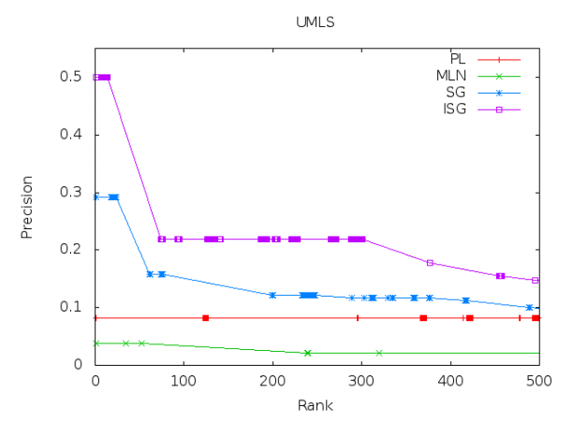
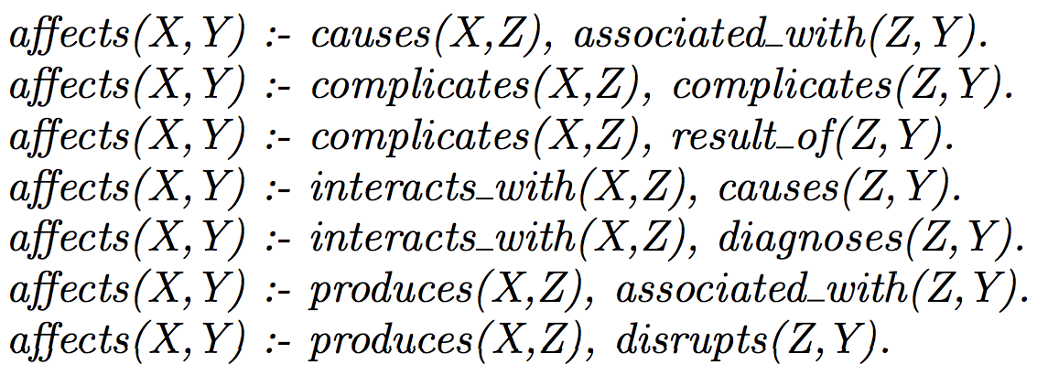
Results on UMLS

Slide 41
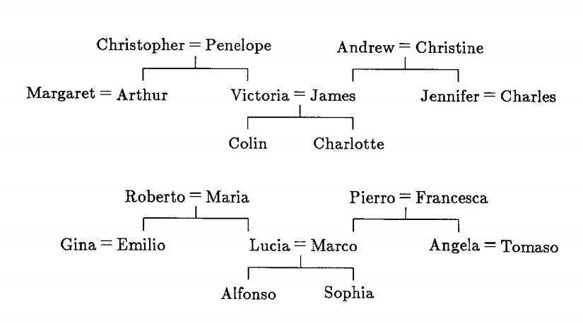
Structure Learning For Expressive Languages From Incomplete DBs is Hard
two families and 12 relations: brother, sister, aunt, uncle, …
corresponds to 112 “beliefs”: wife(christopher,penelope), daughter(penelope,victoria), brother(arthur,victoria), …
and 104 “queries”: uncle(charlotte,Y) with positive and negative “answers”: [Y=arthur]+, [Y=james]-, …
experiment:
repeat n times
hold out four test queries
for each relation R:
learn rules predicting R from the other relations
test

Slide 42
Structure Learning: Example
two families and 12 relations: brother, sister, aunt, uncle, …
Result:
7/8 tests correct (Hinton 1986)
78/80 tests correct (Quinlan 1990, FOIL)
Result, leave-one-relation out:
FOIL: perfect on 12/12 relations; Alchemy perfect on 11/12
:
repeat n times
hold out four test queries
for each relation R:
learn rules predicting R from the other relations
test

Slide 43
Structure Learning: Example
two families and 12 relations: brother, sister, aunt, uncle, …
Result:
7/8 tests correct (Hinton 1986)
78/80 tests correct (Quinlan 1990, FOIL)
Result, leave-one-relation out:
FOIL: perfect on 12/12 relations; Alchemy perfect on 11/12
Result, leave-two-relations out:
FOIL: 0% on every trial
Alchemy: 27% MAP
Why?
In learning R1, FOIL approximates meaning of R2 using the examples not the partially learned program
Typical FOIL result:
uncle(A,B) ⬅ husband(A,C),aunt(C,B)
aunt(A,B) ⬅ wife(A,C),uncle(C,B)
“Pseudo-likelihood trap”

Slide 44
Structure Learning: Example
two families and 12 relations: brother, sister, aunt, uncle, …
New experiment (3):
One family is train, one is test
Use 95% of the beliefs as KB
Use 100% of the training-family beliefs as training
Use 100% of the test-family beliefs as test
I.e.: learning to complete a KB that has 5% missing data
Repeat for 5%, 10%, ….

Slide 45
KB Completion

Slide 46
KB Completion
ISG
Why?
We can afford to actually test the program, using the combination of the interpreter and approximate PPR
This means we can learn AI/KR&R based probabilistic logical forms to fill in a noisy, incomplete KB

Slide 47
Scaling Up Structure Learning
Experiment
2000+ Wikipedia pages on “European royal families”
15 Infobox relations: birthPlace, child, spouse, commander, …
Randomly delete some relation instances, run ISG to find a theory that models the rest, and compute MAP of predictions.
 | 10% deleted | 50% deleted
MLNs/Alchemy | 60.8 | 38.8
ProPPR/ISG | 79.5 | 61.9
MAP - Similar results on two other InfoBox datasets, NELL

Slide 48
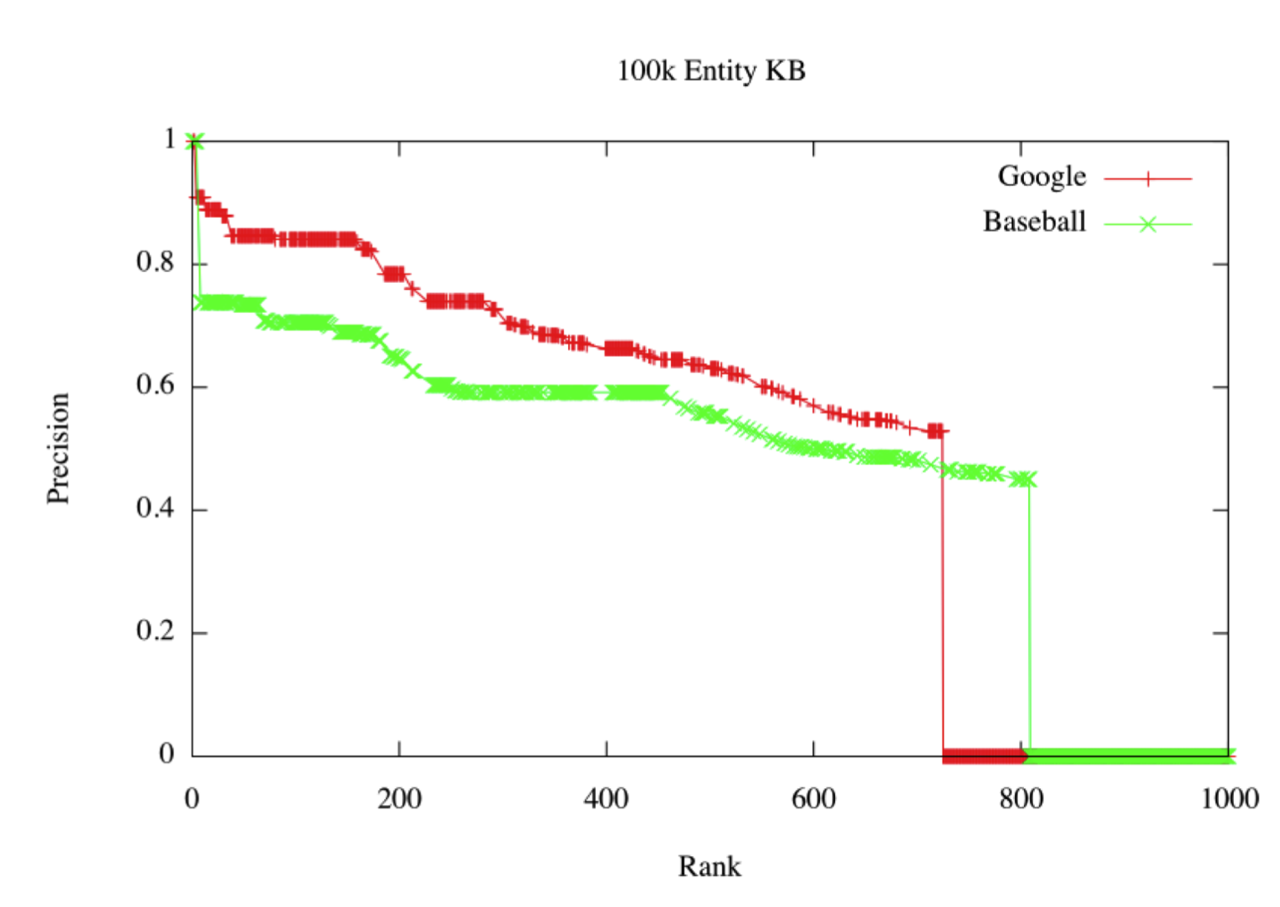
Scaling up Structure Learning

Slide 49
Outline
Motivation
Background
Logic
Probability
Combining logic and probabilities: MLNs
ProPPR
Key ideas
Learning method
Results for parameter learning
Structure learning for ProPPR for KB completion
Comparison to neural KBC models
Joint IE and KB completion
Beyond ProPPR
….

Slide 50
Neural KB Completion Methods
Lots of work on KBC using neural models broadly similar to word2vec
word2vec learns a low-dimensional embedding e(w) of a word w that makes it easy to predict the “context features” of a w
i.e., the words that tend to cooccur with w
Often these embeddings can be used to derive relations
E(london) ~= E(paris) + [E(france) – E(england)]
TransE: can we use similar methods to learn relations?
E(london) ~= E(england) + E(capitalCityOfCountry)

Slide 51
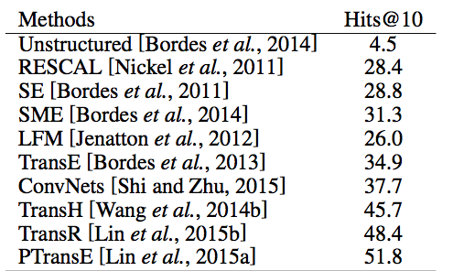
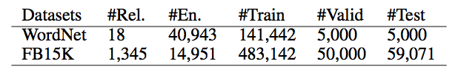
Neural KB Completion Methods
Freebase 15k

Slide 52
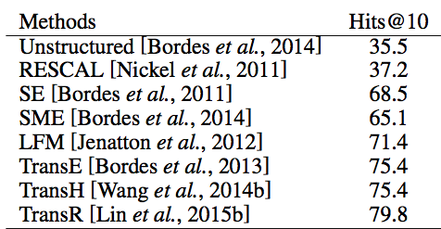
Neural KB Completion Methods
Wordnet

Slide 53
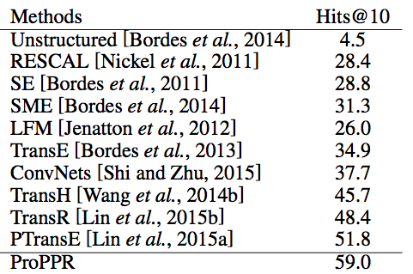
Neural KB Completion Methods
Freebase 15k

Slide 54
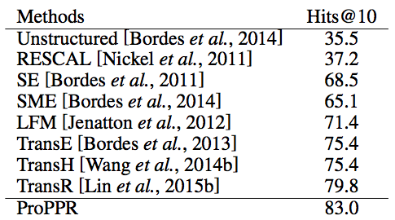
Neural KB Completion Methods
Wordnet

Slide 55
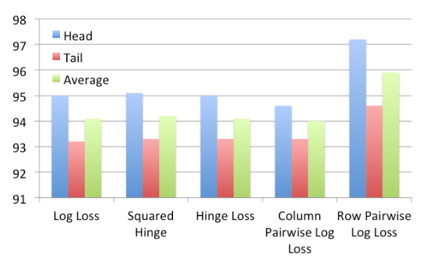
Based on Bayesian Personalized Ranking: all formulas in a positive proof should be ranked above all unused formulas
New parameter-learning method similar to universal schema algorithm (Wordnet dev)

Slide 56
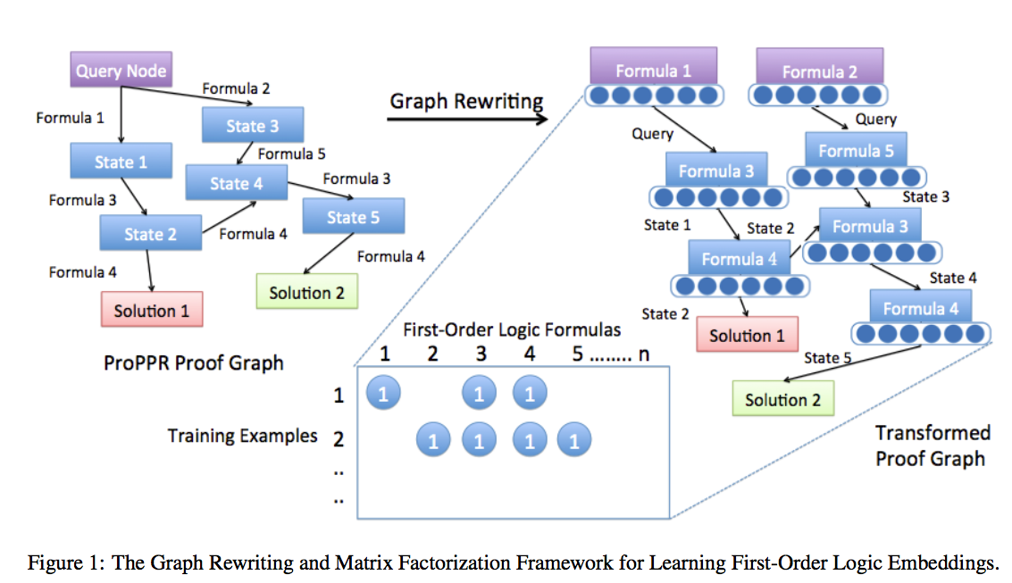

Slide 57
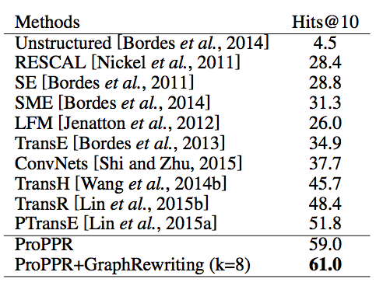
Neural KB Completion Methods
Freebase 15k

Slide 58
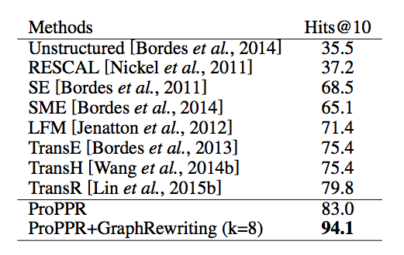
Neural KB Completion Methods
Wordnet

Slide 59
Latent context invention
ACL 2015
Making the classifier deeper: introduce latent classes (analogous to invented predicates) which can be combined with the context words in the features used by the classifier
R(X,Y) :- latent(L),link(X,Y,W),indicates(W,L,R).
R(X,Y) :- latent(L1),latent(L2),link(X,Y,W),
indicates(W,L1,L2,R).

Slide 60
Effect of latent context invention

Slide 61
Outline
Overview
ProPPR:
semantics, inference and parameter learning
Structure learning for ProPPR
task: KB completion
New work
“Soft” predicate invention= in ProPPR
Joint learning in ProPPR
Distant-supervised IE and structure learning
…

Slide 62
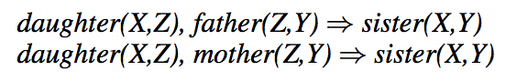
Predicate invention
Predicate Invention (e.g. CHAMP, Kijsirikul et al., 1992 ) exploits and compresses similar patterns in first-order logics:
father(Z,Y) ∨ mother(Z,Y) ➔ parent(Z,Y)
Parent is a latent predicate – there are no facts for it in the data.
We haven’t been able to make this work…. ☹

Slide 63
“Soft” Predicate Invention via structured sparsity
[Wang & Cohen, current work]
Basic idea: take the clauses which would have called the invented predicate and use structured sparsity to regularize their weights together.
Like predicate invention, reduces parameter space
Maybe? leads to an easier optimization problem

Slide 64
“Soft” Predicate Invention via structured sparsity
Basic idea: take the clauses which would have called the invented predicate and use structured sparsity to regularize their weights together.
Graph Laplacian Regularization (Belkin et al., 2006)
Sparse Group Lasso (Yuan and Lin, 2006)

Slide 65
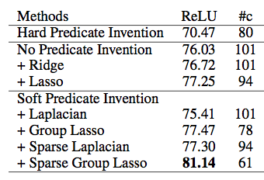
Experiments: Royal Families
MAP Results with non-iterated structural gradient learner.

Slide 66
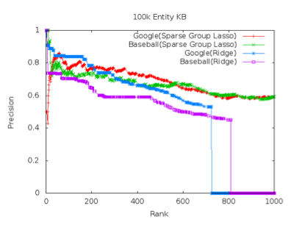
Completing the NELL KB

Slide 67
Outline
Motivation
Background
Logic
Probability
Combining logic and probabilities: MLNs
ProPPR
Key ideas
Learning method
Results for parameter learning
Structure learning for ProPPR for KB completion
Joint IE and KB completion
Comparison to neural KBC models
Beyond ProPPR
….

Slide 68
IE in ProPPR
In March 1849 her father-in-law <a href=“Charles_Albert_of_Sardinia”> Charles Albert</a> abdicated …
Experiment
Same data and protocol
Add facts: nearHyperlink(Word,Src,Dst) for Src,Dst in data
Add rules like:
interp(Rel,Src,Dst) :-
nearHyperlink(Word,Src,Dst), indicates(Word,Rel).
indicates(Word,Rel) :- true # f(Word,Rel)
~= 67.5k links
This is distant supervision:
we know the tuple (rel,src,dst), but not a label for this hyperlink
hyperlink label is latent, and marginalized out by the PPR inference

Slide 69
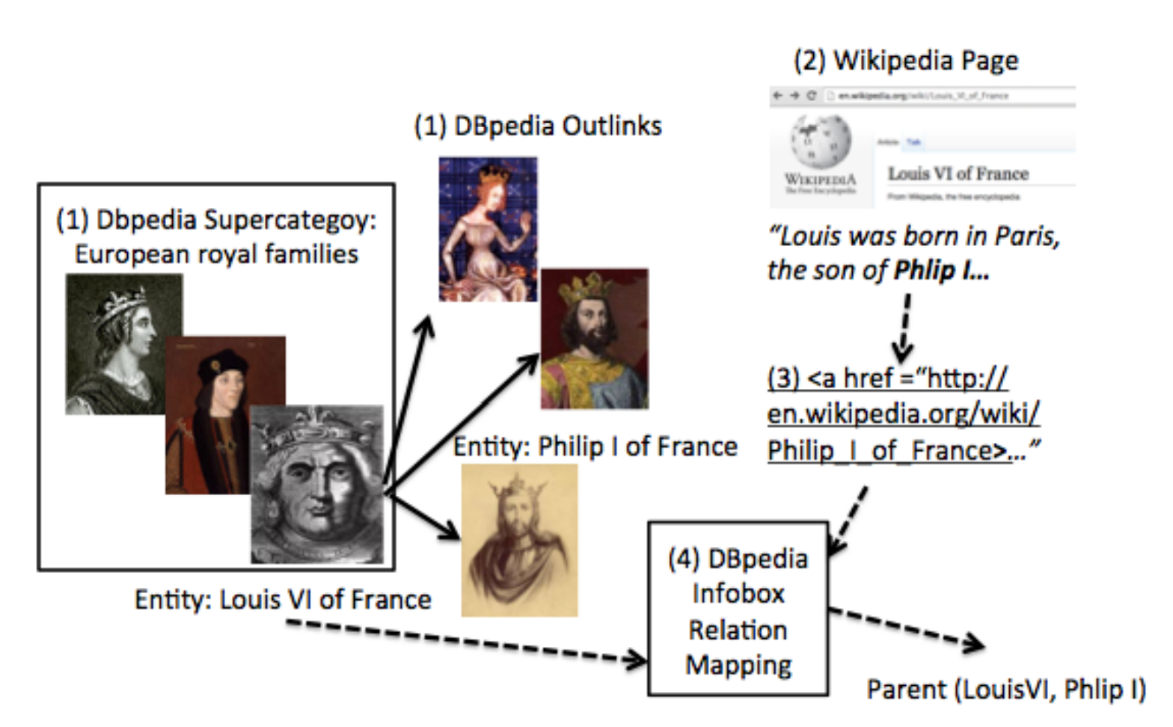
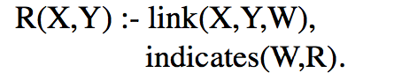
ACL 2015
Data: groups of related Wikipedia pages
knowledge base: infobox facts
IE task: classify links from page X to page Y
features: nearby words
label to predict: possible relationships between X and Y (distant supervision)
Train/test split: temporal
To simulate filling in an incomplete KB: randomly delete X% of the facts in train

Slide 70
Experiments
ACL 2015
Task: KB Completion
Three Wikipedia Datasets: royal, geo, american
67K, 12K, and 43K links
MAP Results for predicted facts on Royal, similar results on two other InfoBox datasets
Notes:
royal: 2258 pages, 15 relations,
american: 679 pages, 12k links, 30 relations
geo: 500 pages, 43k mentions/links, 10 relations

Slide 71
Joint IE and relation learning
ACL 2015
Baselines: MLNs (Richardson and Domingos, 2006), Universal Schema (Riedel et al., 2013), IE- and structure-learning-only models

Slide 72
IE in ProPPR
Experiment
Same data and protocol
Add facts: nearHyperlink(Word,Src,Dst) for Src,Dst in data
Add rules like:
interp(Rel,Src,Dst) :-
nearHyperlink(Word,Src,Dst), indicates(Word,Rel).
indicates(Word,Rel) :- true #f(Word,Rel)
 | 10% deleted | 50% deleted
ProPPR/ISG | 79.5 | 61.9
ProPPR/IE | 81.1 | 70.6
Similar results on two other InfoBox datasets

Slide 73
Joint Relation Learning IE in ProPPR
Experiment
Combine IE rules using nearHyperlink and interpretive rules
 | 10% deleted | 50% deleted
ProPPR/ISG | 79.5 | 61.9
ProPPR/IE | 81.1 | 70.6
ProPPR/Joint IE,ISG | 82.8 | 78.6
Similar results on two other InfoBox datasets

Slide 74
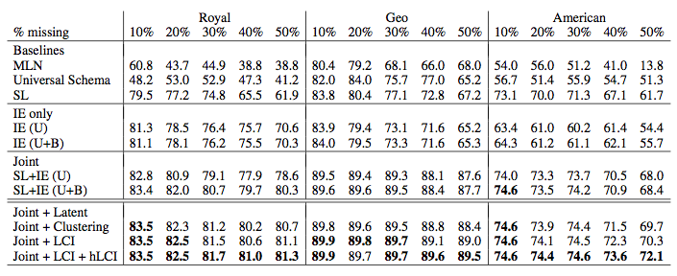
Joint IE and Relation Learning
Task: Knowledge Base Completion.
Baselines: MLNs (Richardson and Domingos, 2006), Universal Schema (Riedel et al., 2013), IE- and structure-learning-only models.

Slide 75
Joint IE and relation learning
ACL 2015
Baselines: MLNs (Richardson and Domingos, 2006), Universal Schema (Riedel et al., 2013), IE- and structure-learning-only models

Slide 76
Latent context invention
ACL 2015
Making the classifier deeper: introduce latent classes (analogous to invented predicates) which can be combined with the context words in the features used by the classifier
R(X,Y) :- latent(L),link(X,Y,W),indicates(W,L,R).
R(X,Y) :- latent(L1),latent(L2),link(X,Y,W),
indicates(W,L1,L2,R).

Slide 77
Effect of latent context invention

Slide 78
Joint IE and Relation Learning
Task: Knowledge Base Completion.
Baselines: MLNs (Richardson and Domingos, 2006), Universal Schema (Riedel et al., 2013), IE- and structure-learning-only models.

Slide 79
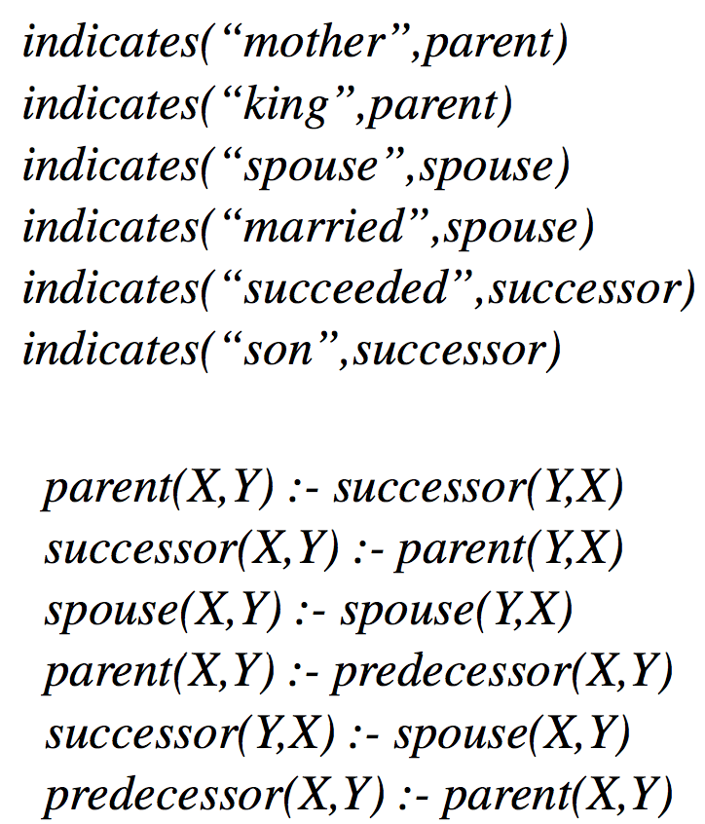
Joint IE and relation learning
ACL 2015
Universal schema: learns a joint embedding of IE features and relations
ProPPR: learns
weights on features indicates(word,relation) for link-classification task
Horn rules relating the relations
Highest-weight of each type

Slide 80
Outline
Motivation
Background
Logic
Probability
Combining logic and probabilities: MLNs
ProPPR
Key ideas
Learning method
Results for parameter learning
Structure learning for ProPPR for KB completion
Comparison to neural KBC models
Joint IE and KB completion
Beyond ProPPR?
….

